Slide 1
巨量資料分析導論新知報告- 淺談圖像辨識與Convolutional Neural Networks
M052040036 蕭伯任

Slide 2
A two-dimensional
array of pixels
CNN
X or O

Slide 3
For example
CNN
X
CNN
O

Slide 4
Trickier cases
CNN
X
translation
scaling
rotation
weight
CNN
O

Slide 5
Deciding is hard
?
=

Slide 6
What computers see
?
=

Slide 7
What computers see

Slide 8
=
x

Slide 9
ConvNets match pieces of the image
=
=
=

Slide 10
Features match pieces of the image

Slide 16


Slide 17
Filtering: The math behind the match

Slide 18
Filtering: The math behind the match
1 x 1 = 1

Slide 19
Filtering: The math behind the match
1 x 1 = 1

Slide 20
Filtering: The math behind the match
-1 x -1 = 1

Slide 21
Filtering: The math behind the match
-1 x -1 = 1

Slide 22
Filtering: The math behind the match
-1 x -1 = 1

Slide 23
Filtering: The math behind the match
1 x 1 = 1

Slide 24
Filtering: The math behind the match
-1 x -1 = 1

Slide 25
Filtering: The math behind the match
-1 x -1 = 1

Slide 26
Filtering: The math behind the match
-1 x -1 = 1

Slide 27
Filtering: The math behind the match
1 x 1 = 1

Slide 28

Filtering: The math behind the match
$$\frac{1+1+1+1+1+1+1+1+1}{9}=1$$

Slide 29
Filtering: The math behind the match
1 x 1 = 1

Slide 30
Filtering: The math behind the match
-1 x 1 = -1

Slide 31
Filtering: The math behind the match

Slide 32

Filtering: The math behind the match
$$\frac{1+1−1+1+1+1−1+1+1}{9}=.55$$
.55

Slide 33
Convolution: Trying every possible match

Slide 34
Convolution: Trying every possible match
=

Slide 35
=
=
=

Slide 36
Convolution layer
One image becomes a stack of filtered images

Slide 37
Pooling: Shrinking the image stack
Pick a window size (usually 2 or 3).
Pick a stride (usually 2).
Walk your window across your filtered images.
From each window, take the maximum value.

Slide 38
Pooling
maximum

Slide 39
Pooling
maximum

Slide 40
Pooling
maximum

Slide 41
Pooling
maximum

Slide 42
Pooling
maximum

Slide 43
Pooling
max pooling

Slide 45
Pooling layer
A stack of images becomes a stack of smaller images.

Slide 46
Normalization
Keep the math from breaking by tweaking each of the values just a bit.
Change everything negative to zero.

Slide 47
Rectified Linear Units (ReLUs)

Slide 48
Rectified Linear Units (ReLUs)

Slide 49
Rectified Linear Units (ReLUs)

Slide 50
Rectified Linear Units (ReLUs)

Slide 51
ReLU layer
A stack of images becomes a stack of images with no negative values.

Slide 52
Layers get stacked
The output of one becomes the input of the next.
Convolution
ReLU
Pooling

Slide 53
Deep stacking
Layers can be repeated several (or many) times.
Convolution
ReLU
Convolution
ReLU
Pooling
Convolution
ReLU
Pooling

Slide 54
Fully connected layer
Every value gets a vote

Slide 55
Fully connected layer
Vote depends on how strongly a value predicts X or O
X
O

Slide 56
Fully connected layer
Vote depends on how strongly a value predicts X or O
X
O

Slide 57
Fully connected layer
Future values vote on X or O
X
O

Slide 58
Fully connected layer
Future values vote on X or O
X
O

Slide 59
Fully connected layer
Future values vote on X or O
X
.92
O

Slide 60
Fully connected layer
Future values vote on X or O
X
.92
O

Slide 61
Fully connected layer
Future values vote on X or O
X
.92
O
.51

Slide 62
Fully connected layer
Future values vote on X or O
X
.92
O
.51

Slide 63
Learning
Q: Where do all the magic numbers come from?
Features in convolutional layers
Voting weights in fully connected layers
A: Backpropagation

Slide 64
Backprop
Error = right answer – actual answer
.92
X
Convolution
ReLU
Fully
connected
Fully
connected
Convolution
ReLU
Convolution
ReLU
Pooling
Pooling
O
.51

Slide 65
Backprop
.92
X
Convolution
ReLU
Fully
connected
Fully
connected
Convolution
ReLU
Convolution
ReLU
Pooling
Pooling
O
.51

Slide 66
Backprop
.92
X
Convolution
ReLU
Fully
connected
Fully
connected
Convolution
ReLU
Convolution
ReLU
Pooling
Pooling
O
.51

Slide 67
Gradient descent
For each feature pixel and voting weight, adjust it up and down a bit and see how the error changes.
error
weight

Slide 68
Gradient descent
For each feature pixel and voting weight, adjust it up and down a bit and see how the error changes.
error
weight

Slide 69
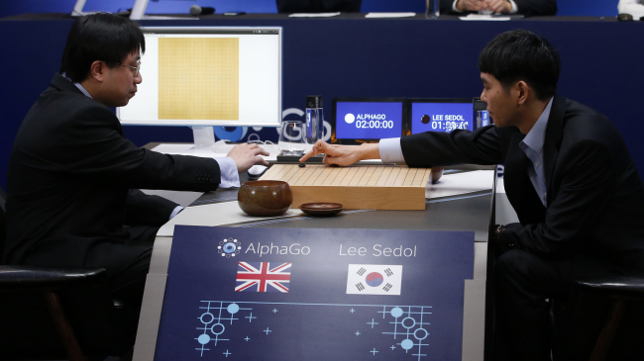
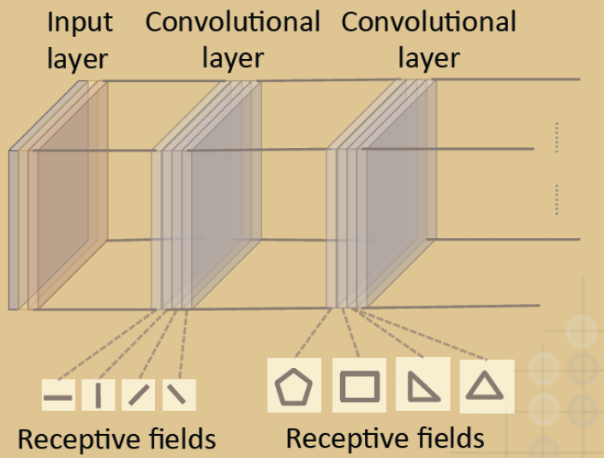

Slide 70

Refrence
https://www.gitbook.com/book/mcknote/brohrer/details
http://ithelp.ithome.com.tw/articles/10187424
Connect with me online:
Brandon Rohrer on LinkedIn
@_brohrer_ on Twitter
#HowItWorks #ConvNet
brohrer@microsoft.com

Slide 71
Thank You
for your
Attention

